Slide 1

Version Control Using git
Adam Sweeney

Slide 2
Introduction
For our development projects, it can be very handy to keep track of the changes we make to our code
If something breaks, we can roll back
We can try out new features without affecting the “main” program
Version control is an extremely important tool used in industry

Slide 3
Agenda
Version control
Using git locally
Repository creation
Staging & Committing
Basic branching

Slide 4

Version Control

Slide 5
What Even is Version Control
The idea of version control is simple
Create a controlled way to track changes we make to our project and provide access to all the different versions
Version control has existed long before programming
Look at any textbook, it’s usually on its nth edition

Slide 6
We Always Have a Choice
There are many “schemes” for software version control
svn
git
mercurial
cvs
…etc.
The focus of this lecture is using the git scheme
Open source, developed by Linus Torvalds
Rapidly gaining in popularity across industry

Slide 7
Using git Locally

Slide 8
Installing git
We can’t use git if it’s not on our system
Linux - install git using your distro’s package manager
Windows - install from https://git-scm.com
Optionally use a Windows package manager like chocolatey or scoop
Mac - install from https://git-scm.com
Optionally use homebrew

Slide 9
Setting up git
We just need to enter two commands
Open a terminal:
git config --global user.name [your name]
git config --global user.email [your email]
Optional setup
Set your editor (for commit messages, vim by default)
git config --global core.editor “path/to/editor”

Slide 10
Getting Started
We do not have to wait until we have a new project
It’s never too late to put our work under version control
We do need to organize our work, however
At a minimum, each project should be contained in its own folder
From a terminal, navigate to your project folder
Type git init
An empty repository is created

Slide 11
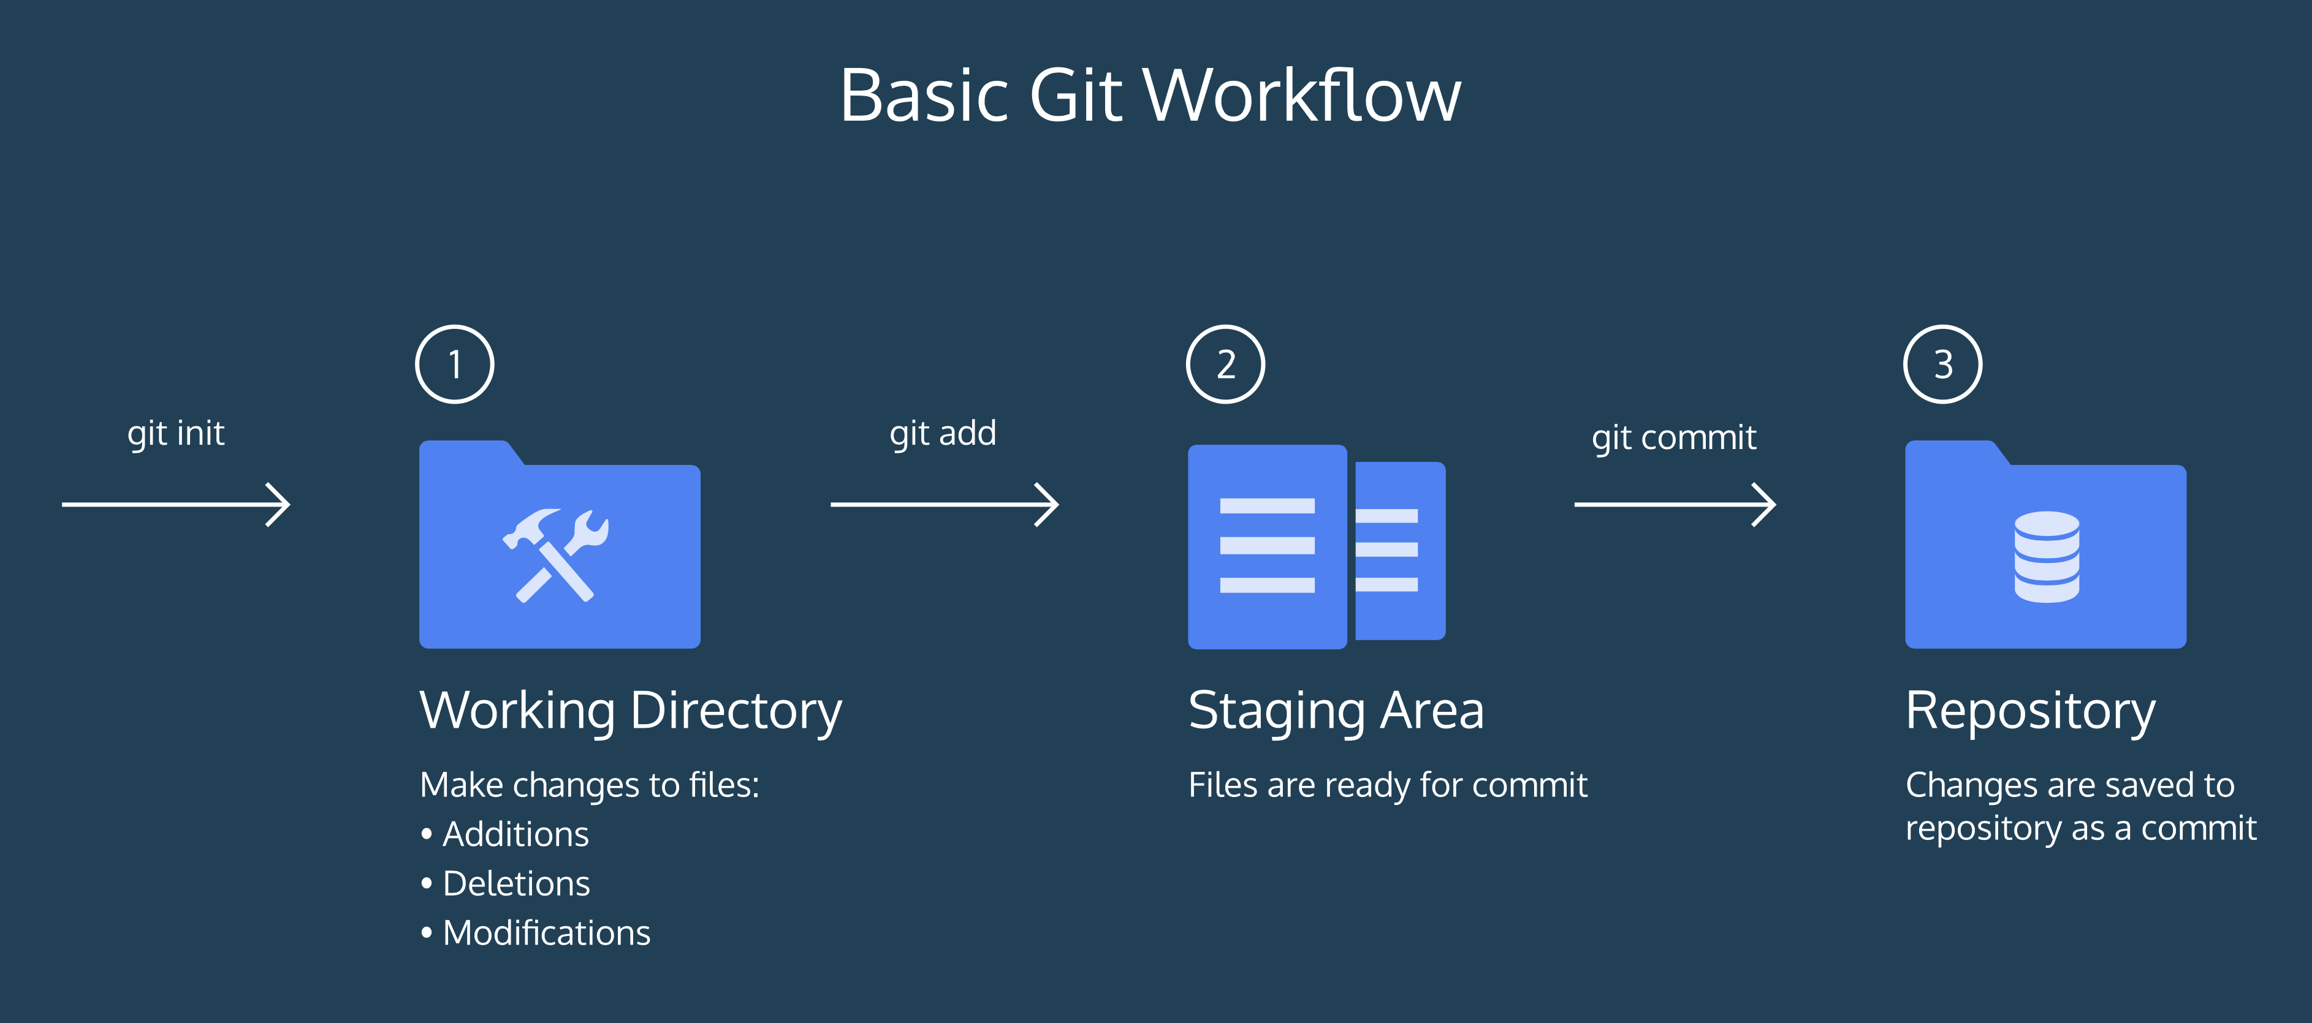
The git Process*
Notes:
* Images taken from the git course on https://www.codecademey.com

Slide 12
Our Workflow
We edit our code, we save our code
Same as we’ve ever done
To save it to our repository, we must first stage the files to be committed
Staging is a way of saying that we’re done altering that file for now
Stage by using the command git add [FILENAMES]
We can always check the status of our repository by using the command git status

Slide 13
Committing Files
After we stage all the files that we have edited/want to add, we are ready to commit them
git commit -m “MESSAGE”
Message should be written in the present-tense, and kept short (< 150 characters)
git commit is technically all we need
Opens a text editor for us to enter a message
ALWAYS include a message; it is best practice

Slide 14
git Tracks EVERYTHING
In a project folder, git keeps track of everything
There will likely be files we do not want it to track and bother us about
We can tell git to ignore these files
In the working directory, create a file called .gitignore
It is a plaintext file where we list the files we don’t want git to track
We can name specific files and use wildcards
We can get gitignore lists from GitHub
https://github.com/github/gitignore

Slide 15
Viewing Our Commits
There will come a time when we want to see our commit history
Finding out when a bug cropped up
Observing evolution of project
Finding who to blame when everything’s broken
This can be done using the command git log

Slide 16
What git log Shows You
Commit number
Every commit is numbered with a hash value, generated using SHA
What branch the commit was made to (more on that later)
Commit author
Commit timestamp
Commit message

Slide 17
git reset
If I have staged a file but wish to unstage it, I can use the following command
git reset FILENAME
Does not change working directory, the file is merely unstaged
Also possible to roll back entire repository if no filename is specified
git reset --hard COMMIT
Changes working directory to match a specific commit

Slide 18
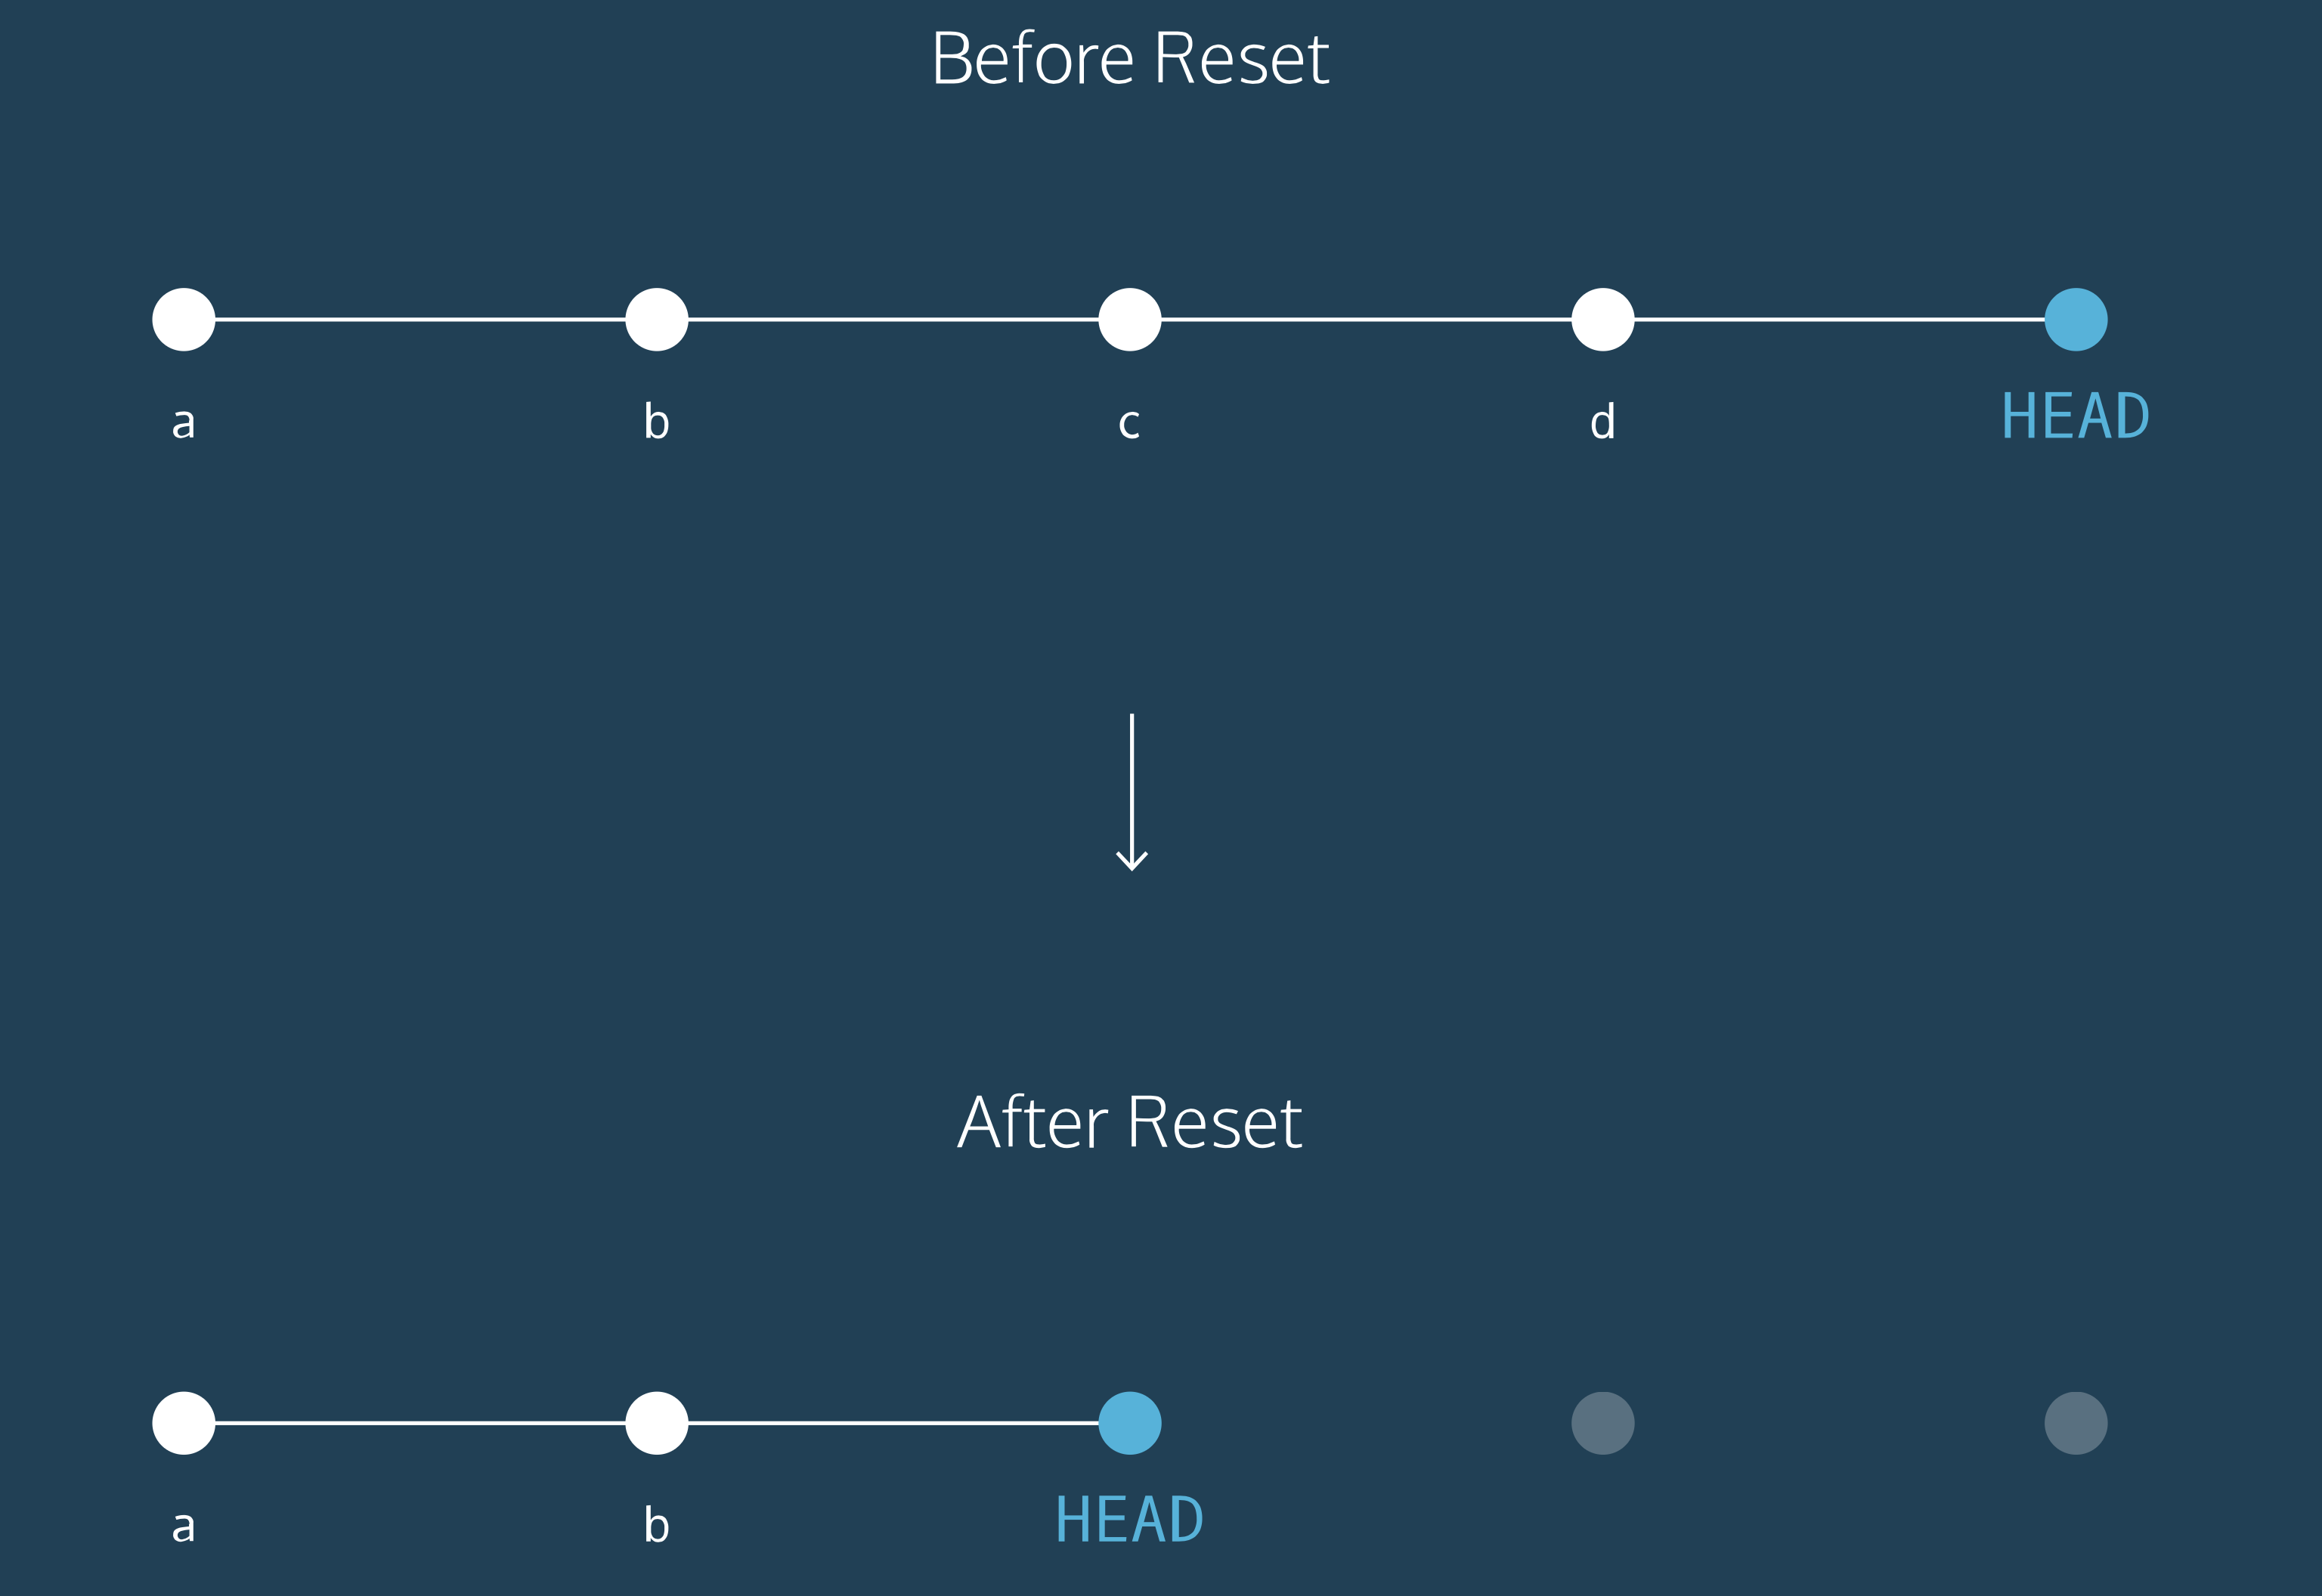
Visualization of git reset

Slide 19
Branching
Oftentimes, we are afraid of adding new features or experimenting with new syntax because we could break what we have
More importantly, no company wants their money maker in a broken state just to see if a new feature or refactor will pan out
git allows us to perform these experiments without affecting our “master” code

Slide 20
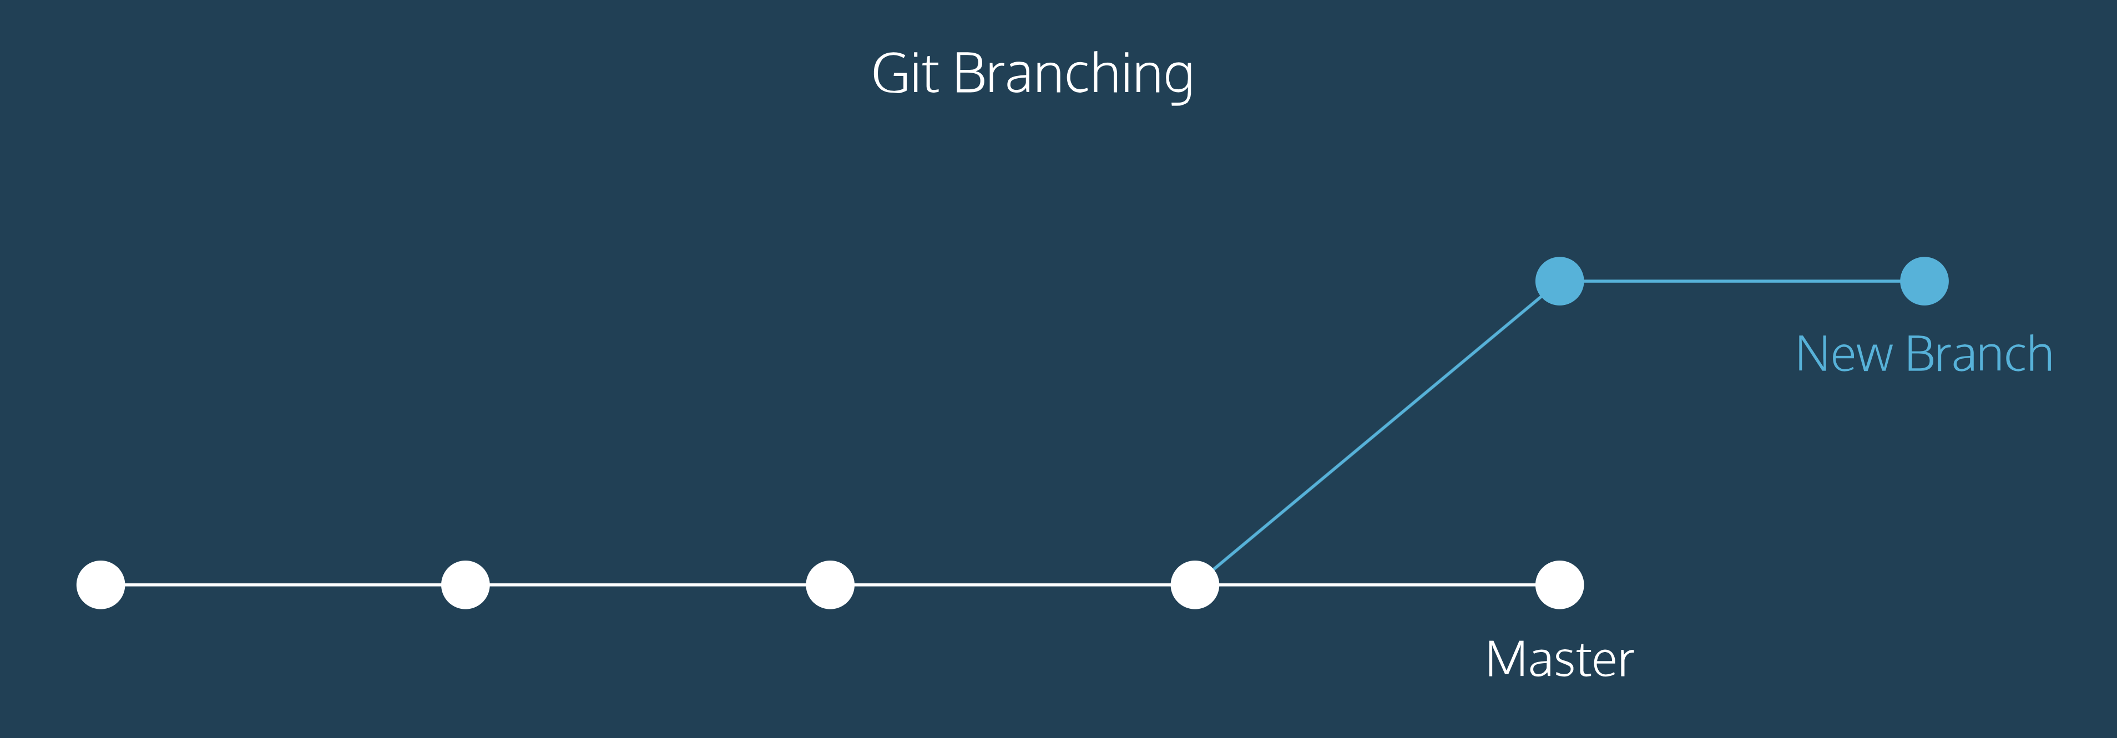
A Visualization of git Branching

Slide 21
Creating a New Branch
Simply use the command git branch BRANCH_NAME
The branch name may not contain whitespace
If we type git branch without specifying a branch name, git lists all the branches, with a * marking our current branch

Slide 22
Switching Branches
git checkout BRANCH_NAME
This will switch your branch; the branch must exist first
git checkout -b BRANCH_NAME will create a branch and switch to it
Now, when staging and committing changes, they will be committed to the current branch, and not to the master
This can be observed my making changes to a branch, committing those changes, and switching branches back to master

Slide 23
Bringing it Back
The goal of a branch is to incorporate it back to master
From the master branch: git merge BRANCH_NAME
The branch specified in the merge command is the “giver” branch
The branch you execute the command from is the “receiver” branch

Slide 24
Upon Successful Merging
We usually want to delete the branch
Branches are a means to an end
Many branches have no use after being merged
git branch -d BRANCH_NAME

Slide 25
git is a Powerful Tool
We’ve only scratched the surface
Most glaring omission right now is lack of discussion about online repositories for collaboration
But that’s coming
In the meantime, here some resources for learning more about git

Slide 26
Resources
https://www.codecademy.com
https://www.atlassian.com/git
https://www.git-tower.com/learn/git/ebook
https://git-scm.com/doc
git help
git help TOPIC

Slide 27
Review
Version control
Using git locally
Repository creation
Staging & Committing
Branching
Merge Conflicts

